Slide 1
Running and Gunning with PNREAP: What you can do when you are in the hot seat
Mallory Rahe
Extension Community Economist
Oregon State University

Slide 2
Getting ready to use the website
Tell a good story, think through the questions you have as you look at this data and try to anticipate questions, which might require additional data or calculations
A good story is not one sided
The plot is found after careful data analysis not before
Places the work on you not your audience
Time consuming but rewarding endeavor

Slide 3
What does storytelling have to do with data analysis?
Careful thought process to guide your navigation, collection, and synthesis of place based data.
Good storytelling requires meaningful and conscious data choices. It is a place-based tailored presentation.
Encourages you to think about the implications behind the numbers and find people in the data.
Guided by a set of iterative questions, it places the burden of interpretation and cohesion on the analyst and allows maximum uptake by the audience.
Incorporates additional questions and data analysis and promotes combining diverse sets of data.
Provides the necessary context for thinking about implications and policy response discussions.

Slide 4
Scenario: Create a place profile
My set of starting questions:
What is Curry’s regional identity? Job provider, bedroom county, or self sufficient?
Is the county rural or urban? Which counties are most similar in terms of total size, economic opportunity, population base, income earnings?
Is the county growing, declining, or in a period of job and population stability?
What is driving this change? What kind of industries do they have? High or low paying? Government or farm dependent? Entrepreneurial?
What have been the most dynamic changes in the industrial base?
Is this place competitive? Does it have a favorable mix of industries?
Which industries are contributing to growth now?
How has the county’s population changed? Growing, declining? Purchasing power through average earnings, and standard of living?
What sources of income are most essential to this county? Which industries? What are the current trends and importance of other sources of income?
Use a list to provide an initial scope but your investigative inquiry will suggest additional questions

Slide 5
Tools on PNREAP Website to aid your quest
Benchmark (LSGL, Comparative, Graphic Trends)
Situate your county or counties with their state and regional context
Change over time (Trends Analysis, Shift Share)
Current position and direction and rates of trends
Key components, specializations (Location Quotients, Shift Share, Industry Structure & Performance)
What makes this place unique: identity, opportunities, outcomes, and futures
Know your data definitions, read the fine print, always include citations

Slide 6
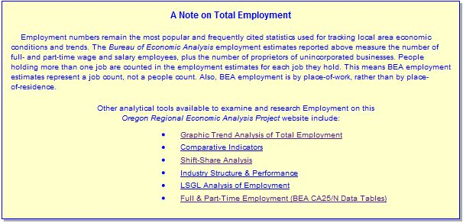
Use statewide maps to start with a regional context
Take advantage of the ample documentation on PNREAP to know your data definitions, and source your work well so you know how to replicate it in the future
Notes:
A Note on Total Employment Employment numbers remain the most popular and frequently cited statistics used for tracking local area economic conditions and trends. The Bureau of Economic Analysis employment estimates reported above measure the number of full- and part-time wage and salary employees, plus the number of proprietors of unincorporated businesses. People holding more than one job are counted in the employment estimates for each job they hold. This means BEA employment estimates represent a job count, not a people count. Also, BEA employment is by place-of-work, rather than by place-of-residence.

Slide 7
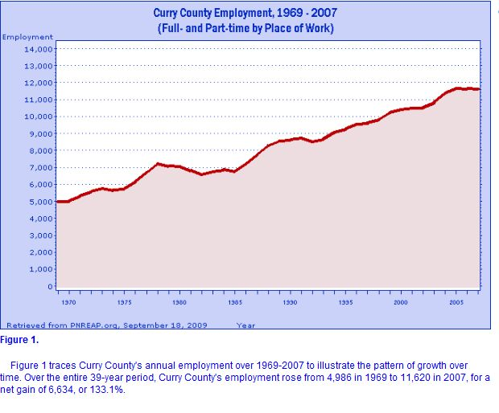
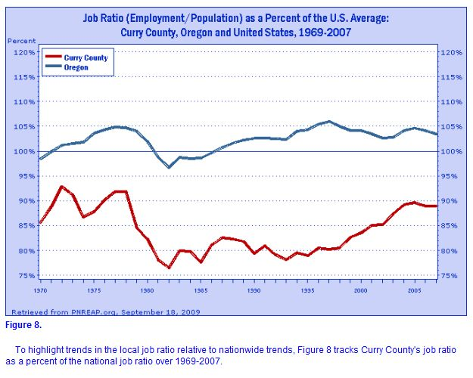
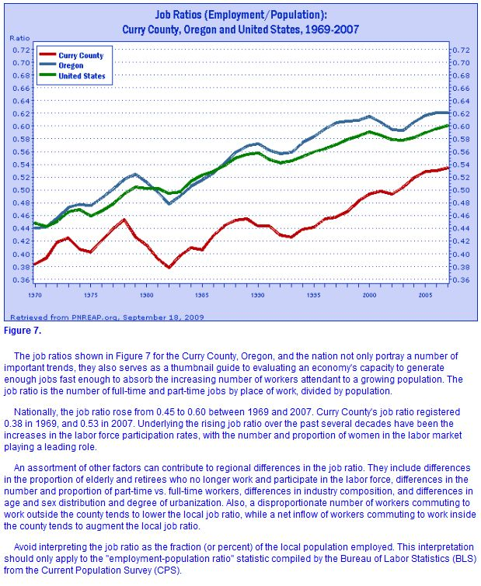
10 tools for Understanding Employment Change: Graphical Trends Analysis
Save 1. Graph Employment by Place of Work and 10. Table Curry County and Oregon Employment for use with the Shift Share section and the discussion of employment change by industry
Figures 7 and 8 provide two displays of the job ratio, or the employment to population ratio for the county. This calculation provides an important link to understanding how population and employment changes are intertwined.

Slide 8
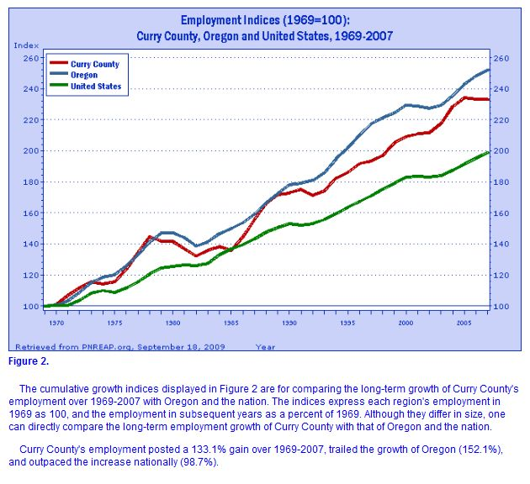
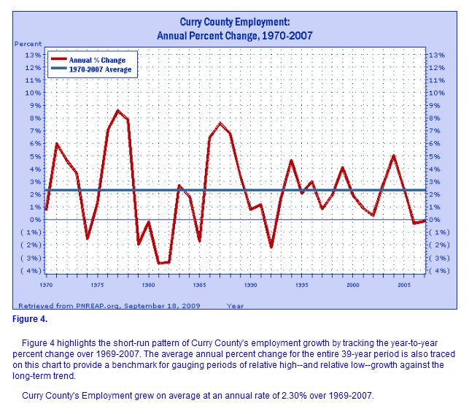
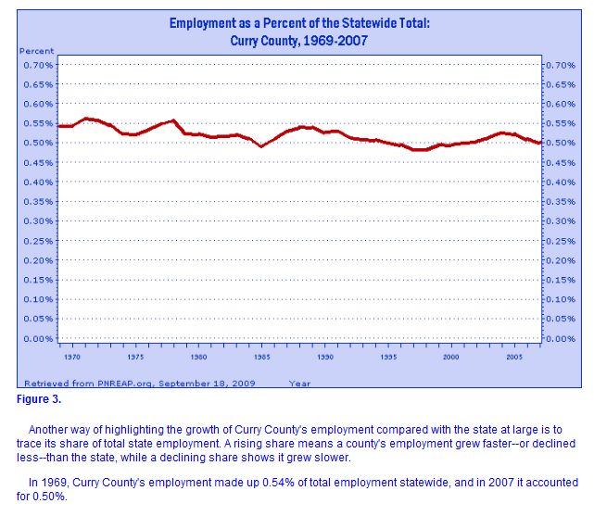
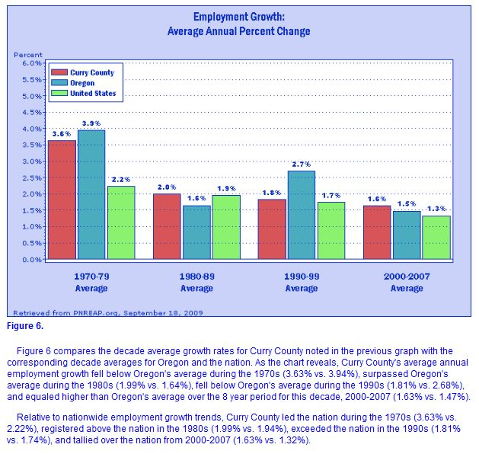
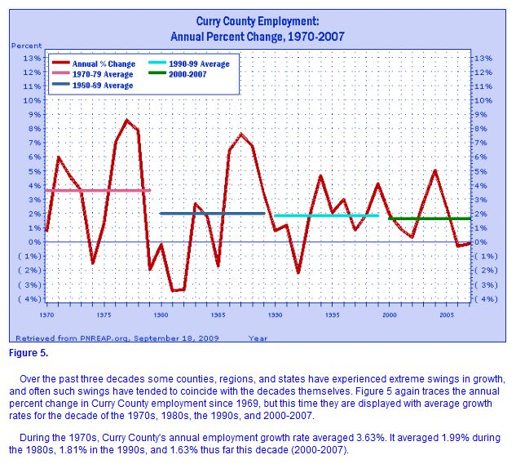
Figures 2-6 all provide various graphical representations of employment change. What representation most accurately describes the key points of your data?
Include the figure text in the notes section of PowerPoint slides, but also restate in your own words on the slide itself.

Slide 9
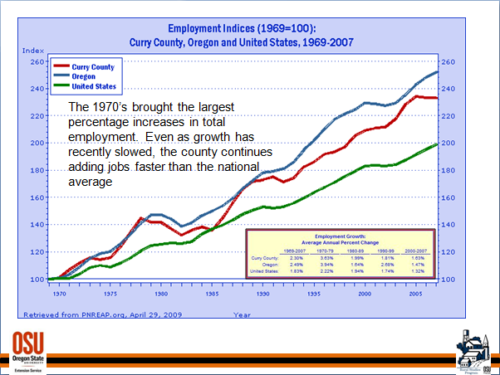
Understanding Employment Change through graphics

Slide 10
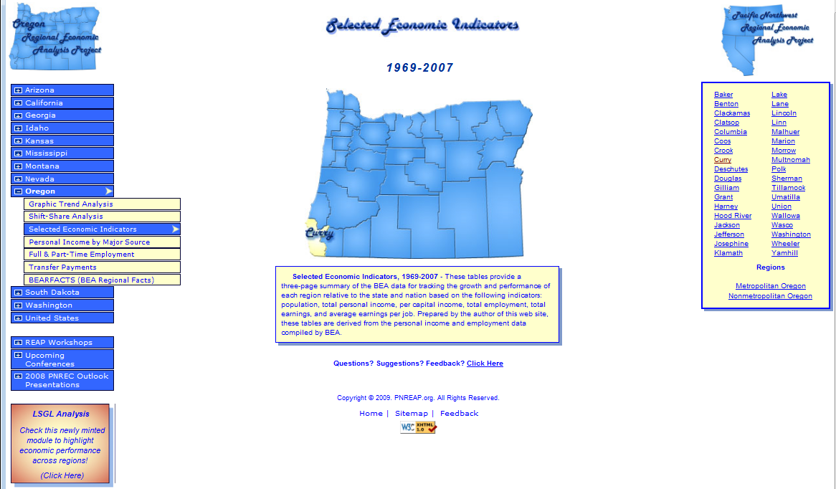
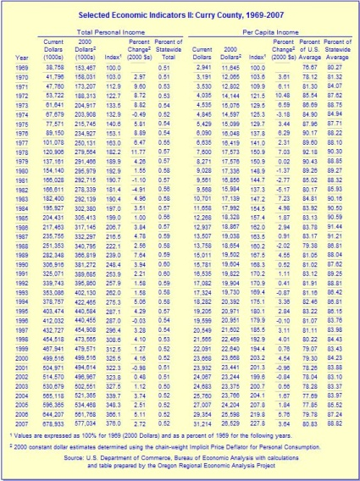
Use the reference tables of data under Selected Economic Indicators as an appendix and for slide text

Slide 11
Using the Shift Share feature to explain employment change by industry mix, competitiveness, and national growth effects
Your first decision is in the choice of year.
Data changes restrict availability within two time periods 1969-2000 or 2001-2007
Dynamic periods of change in employment or unemployment rates, job ratio changes, peak to through, or peak to peak
Perhaps the last time an analysis was done on employment by industry

Slide 12
One alternative: Use business cycles to determine choice of years in shift-share analysis
Graphic Trends Analysis: Employment Figure 1
Selected Economic Indicators I: Employment by Place of Work
This analysis can be very sensitive to the period chosen, clearly state your choice of years.

Slide 13
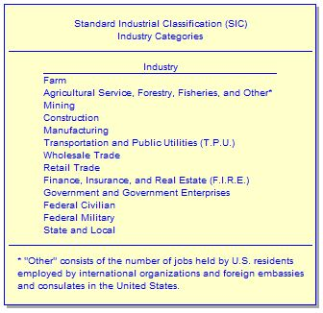
From the output menus, choose the amount of information you feel comfortable explaining.
This is the real value of the shift-share analysis, display this or describe in your own words.
Shift-share analysis also offers a quick calculation of employment shares and percent change by industry.

Slide 14
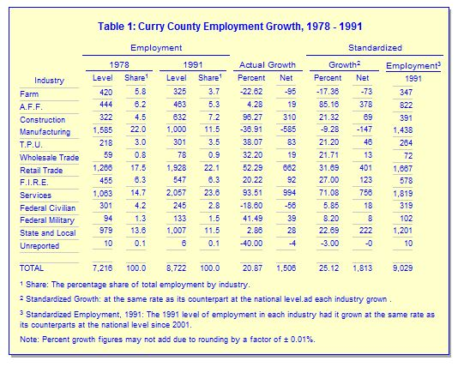
Location Quotients can help you identify your degree of specialization
Time allowances?

Slide 15
Tying in population to find a story about people
Figures 7 & 8 under Graphic Trends – Employment display the changing job ratio
The job ratio offers a quick look at how population and total employment in a county are changing.
Are jobs being filled by in-migrants, new labor force entrants, commuters, the unemployed, or by second job holders?
This is an opportunity to collect additional information from the Census
Notes:
Commuters
Previously unemployed
New labor force participants
Second jobs
In-migrants

Slide 16
Providing context for county population change

Slide 17
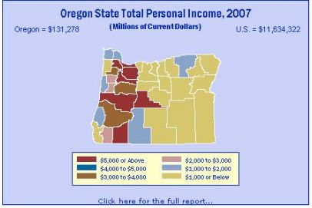
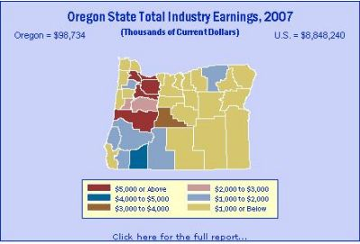
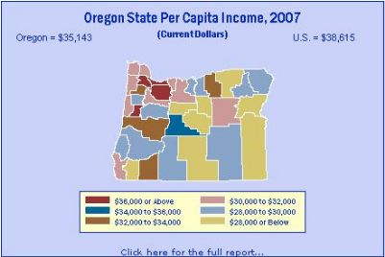
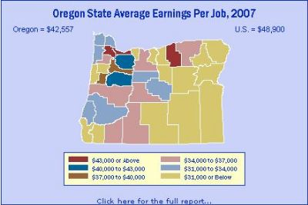
Examining Income

Slide 18
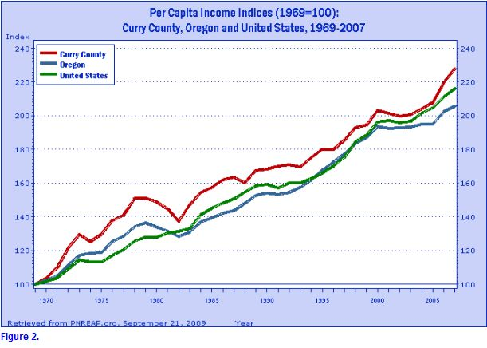
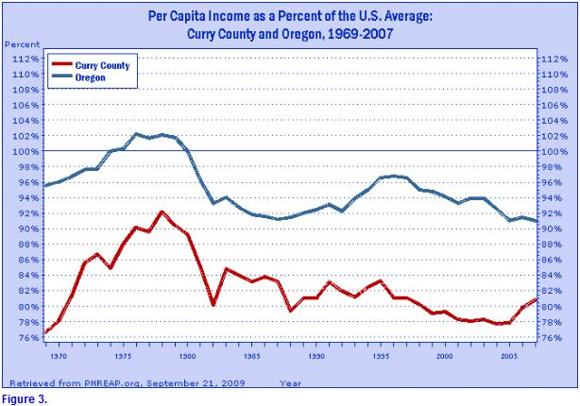
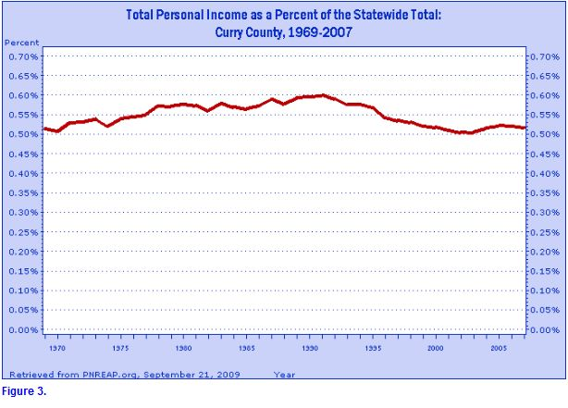
Be selective, use short sentences to capture the essence of a graphic
A great way to keep yourself engaged in the process as well, are you capturing the highlights? What about this story does not yet make sense? What is missing?

Slide 19
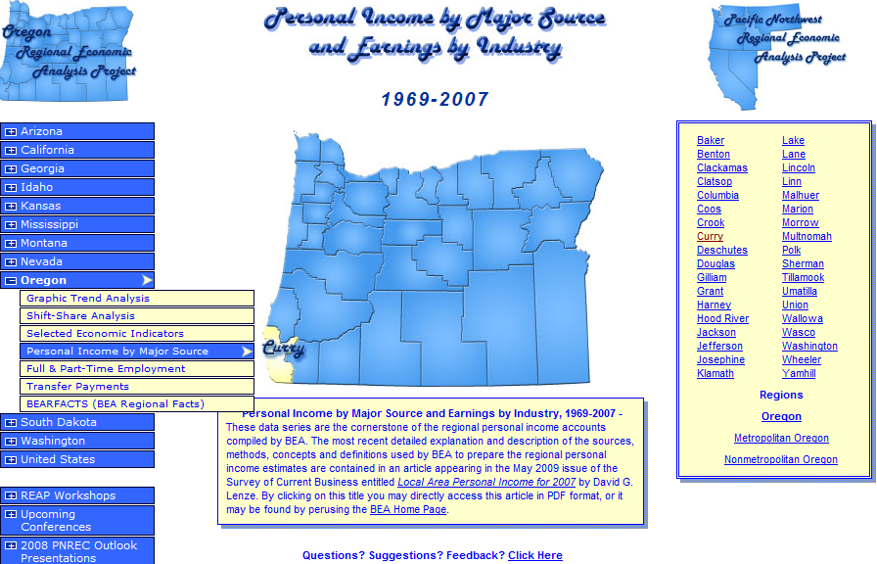
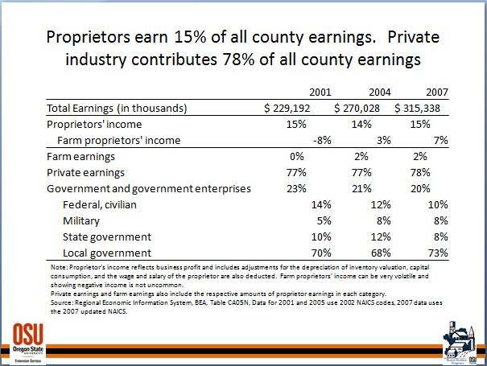
Personal Income by Major Source and Earnings by Industry

Slide 20
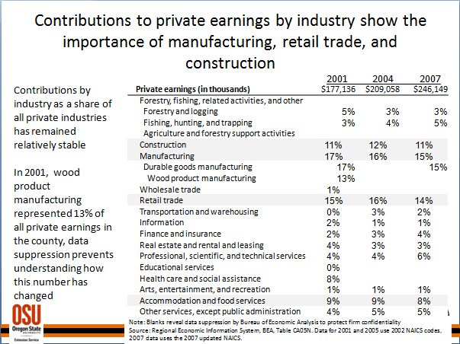
Additional Industrial Detail
Disclosure issues do arise, especially in smaller counties
A great application for location quotients and a host of additional calculations
Think about what will resonate the most with your audience – this shows percentages instead of whole numbers and do to the relative stability does not show percent change

Slide 21
The power of comparisons
Components of Total Personal Income
Curry County
Oregon
Net earnings
Dividends, interest and rent
Total personal current transfer receipts
40.3%
31.5%
28.2%
64.1%
20.5%
15.3%
A great example of a county economy whose story cannot be told through industry alone. In Curry, industries only contribute 40 percent of total personal income.

Slide 22
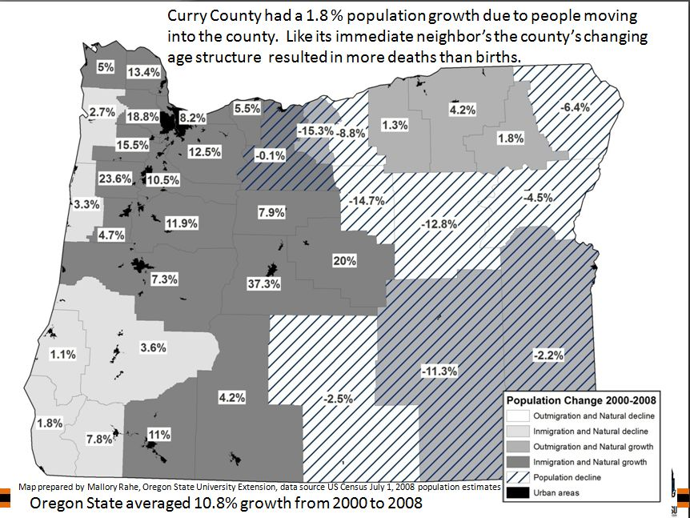
On the stump…
Develop a life long passion for data
Track new developments and changes in definitions
Take the time to create customized representations of commonly requested data or information
Telling good data driven stories takes time and practice

Slide 23
Use the website as a starting place for additional calculations and representations
Data taken from Full time & part time employment by Major Industry (Table CA 25)
Add value to your work by summarizing major points in titles
Combine figures and text in a way that offers the audience the big picture and the important details.
In 1969, the manufacturing industry provided 1,724 jobs or 1/3 of Curry County’s workforce. By 2000, manufacturing had dropped to 905 jobs or 9 percent of the county’s workforce.
Source: Source: U.S. Department of Commerce, Bureau of Economic Analysis, Table CA 25 with calculations and table prepared by the Oregon Regional Economic Analysis Project www.pnreap.org

Slide 24
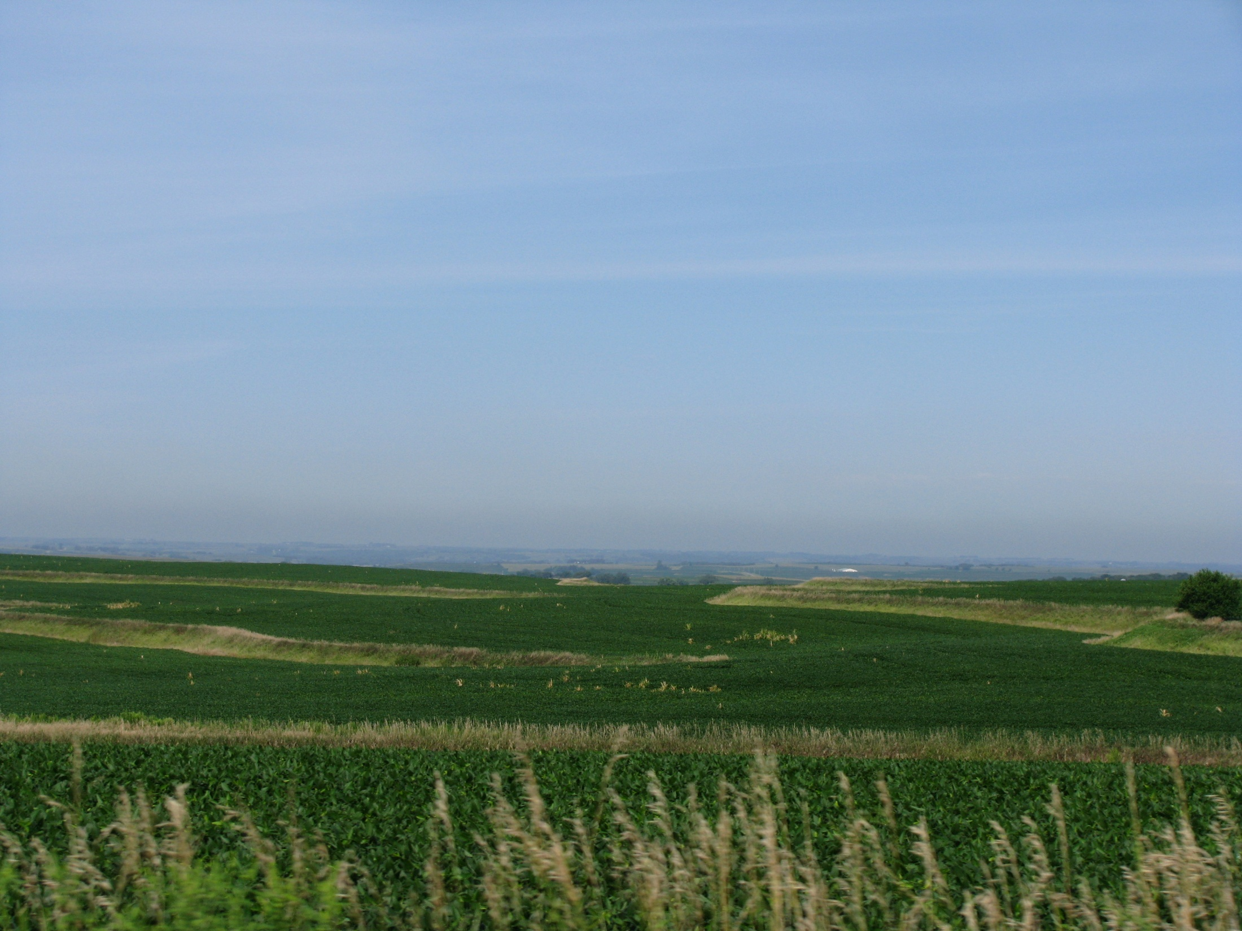
Thank you, and I welcome your questions and comments…

Slide 25
Appendix
Enabling the Windows Vista Snipping Tool
Click on Vista Start button, and go to Control Panel.
Click on Programs link.
Click on Turn Windows features on or off link. If User Account Control pops up for confirmation, click on Continue button.
Scroll down the list of features in Windows Features dialog window, tick the check box for Tablet-PC Optional Components to enable and show the Snipping Tool in Vista.
Use options to change automatic ink borders, screen overlays, and save options.

Slide 26
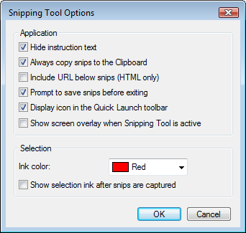
Customizing Windows Snipping Tool
Screen Overlays and showing a selection ink border are standard options that might not meet your needs.

Slide 27
Quick tips on creating PowerPoints from websites
Make the program work for you, instead of working against it
Use the quick access toolbar (19 tools)
Create slide and presentation templates
It pays to take the time to challenge automatic formatting
Develop good templates once, and every project will be easier afterwards = font, colors, borders
Think of PowerPoint, Word, Excel as part of your tools and invest the time to learn how to use these tools effectively. It will increase your work’s visibility and impact
The use and value of the data comes before flashy graphics… but there is plenty of space where no trade-offs are necessary!

Slide 28
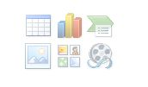
Inserting pictures into PowerPoint
Use the windows vista snipping tool or print screen options (highlight the program first)
Use the insert picture option to avoid hassling with oversized images
Save all images together in a project file

