Slide 1
Analysis of Growth and Change Among the Major Components of Personal Income within Douglas County: 1969-2007
Tom Harris
Professor and Director
Department of Resource Economics
University of Nevada, Reno

Slide 2
Douglas County: Show Me the Money
In 2007, Per Capita Income in Douglas County was $56,558.
Douglas County is ranked 40th highest among the nation’s 3,140 counties.
In 2007, Douglas County’s Average Earnings Per Job was $35,150.
This ranked Douglas County 13th among Nevada’s 17 counties.
What does this discrepancy mean?
What makes up Per Capita Income?

Slide 3
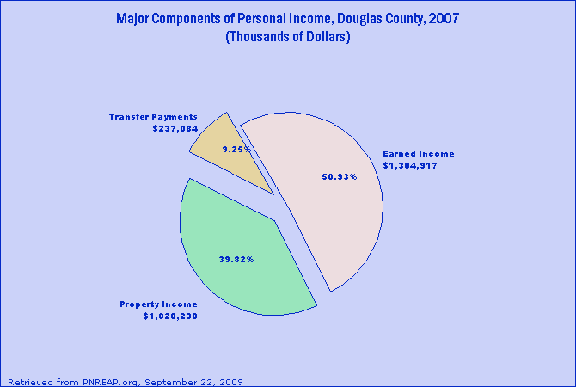
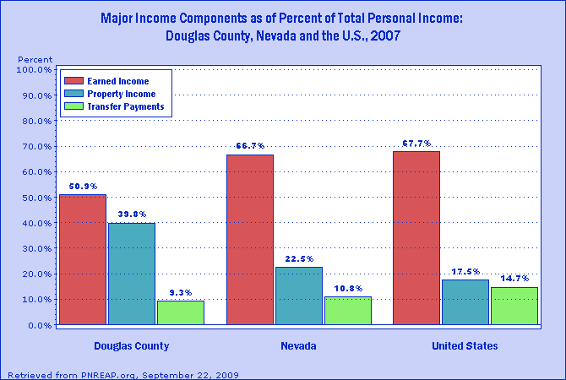
Fig.1. Major components of personal income for Douglas County, NV.
Fig.2. County, State, and National comparison of major personal income components.
The share of Douglas County's personal income that originates as property income (39.8%) is well above the share nationally (17.5%).
The share of Douglas County's personal income that stems from transfer payments (9.3%) is below the national average (14.7%).
In combination, property income and transfer payments amounted to 49.1% of Douglas County's income in 2007. Earned income made up the balance with 50.9% of personal income, which amounted to a substantially smaller share than the corresponding 67.7% for earned income nationwide.

Slide 4
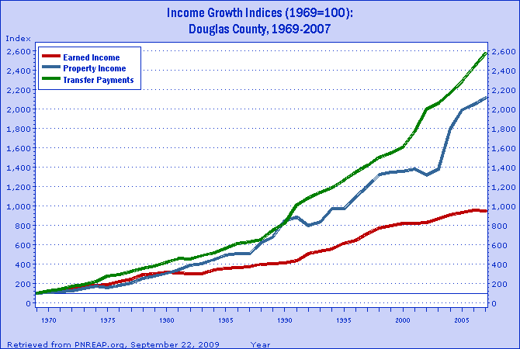
Figure 3. Comparison of the real (that is, removing the effects of inflation) cumulative growth of the three major components of personal income for Douglas County from 1969-2007. The cumulative growth indices express each income component as 100 for the base year of 1969, and represent each component in subsequent years as a percent of their level in 1969. The indices enable a direct comparison of the differences in the cumulative percentage growth of the earned income, property income, and transfer payments for Douglas County over more than three decades.
Notes:
One of the key objectives of this report is to highlight the growing importance over the past several decades of property income and transfer payments and to illustrate their emergence as more prominent components of local area personal income.

Slide 5
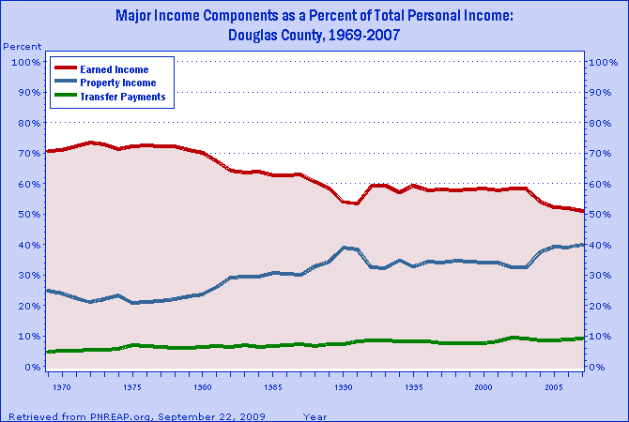
Figure 4. While the previous graph illustrates the degree of growth among the three major components of personal income, the above figure traces their changing share and relative importance over time. Differences in growth among the three income components translates the changes in their relative share, as shown here. Earned income as a share of Douglas County's personal income declined from 71% in 1969 to 51% in 2007; a shift in relative share of -20%. Offsetting this decline was a 15% increase in property income's share from 25% in 1969 to 40% in 2007; and a 4% advance in transfer payments share, from 5% to 9% over the same period.

Slide 6
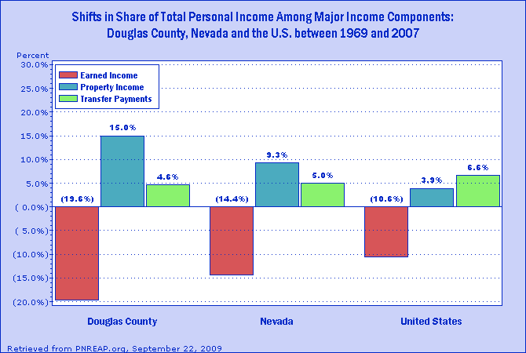
Figure 5. Earned income's share statewide and nationally declined by -14.4% and -10.6%, respectively, while in Douglas County it declined by -19.6% from 1969-2007. Nationally, the shift in share of property income and transfer amounted to 3.9% and 6.6%, respectively, while the corresponding shifts in share in Douglas County amounted to 15% and 4.6%, respectively. A notable increase in the share of property income is often associated with an influx of relatively affluent retirees.

Slide 7
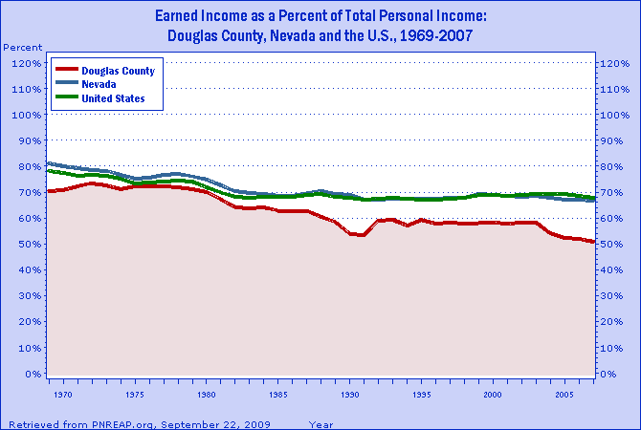
Figure 6. Earned income as a percent of personal income for Douglas County, the State, and the Nation from 1969-2007. Generally, local, state, and national earned income share declines were most prominent from 1979 to the mid-1980s. Some localities and regions experienced pronounced short-term swings in earned income because earnings generation was concentrated in industries especially sensitive to major cyclical swings in the national economy. Mining, wood products and durable goods producing manufacturing, such as primary metal and transportation (including air and motor vehicle equipment), are among the most notable cyclically sensitive industries.

Slide 8
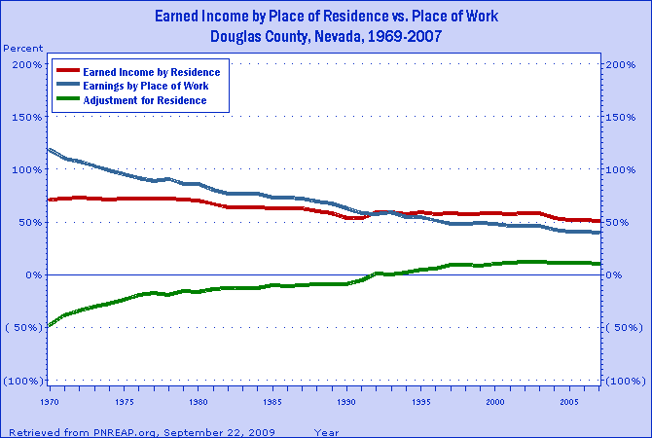
Figure 7. Personal income, and its three major components, are intended to measure the incomes of the residents of a region. Accordingly, the earned income data reported and presented in this report are "by place of residence." But in fact, earnings data are first collected and reported as "earnings by place of work." That is, they reflect earnings on the basis of where workers work, and not on the basis of where they live. To develop an estimate of earned income based on where workers live, the Bureau of Economic Analysis develops an "adjustment for residence" to take into account the earnings of such inter-county commuters.

Slide 9
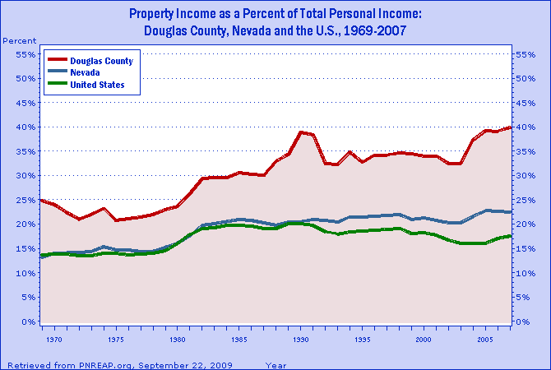
Figure 8. Property income as a share of personal income locally, statewide, and nationally from 1969-2007. Common to all three is the rise and advancement of property income’s share to a new plateau from 1979-82. This period was plagued by double-digit rates of inflation and interest. This played a leading role in the growth and rise in share of property income over 1979-82. Moreover, contained within the period 1979-82 were two back-to-back recessions. Unlike many recessions, the early 1980s recessions were disbursed regionally so declines in the share of earned income were often observed, further bolstering property income's share during this period.

Slide 10
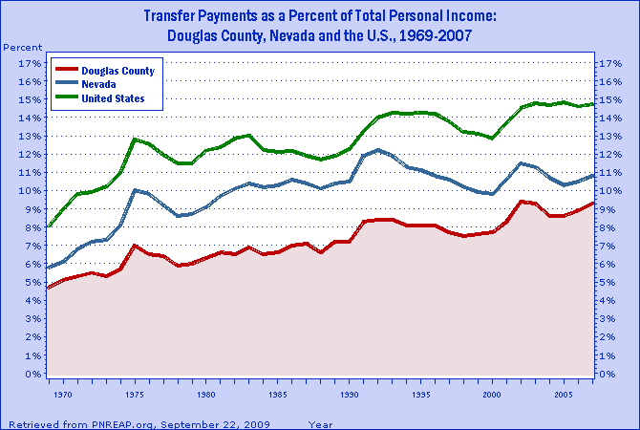
Figure 9. Personal income is attained by participating in current production or from transfer payments. Earned income and property income represent payments received for participating in production. Transfer payments are payments made by government to individuals "for which no current services are performed." Examples include Social Security and unemployment benefits. Nationally, transfer payments as a share of personal income advanced from 8.1% in 1969 to 14.7% in 2007, for a net gain of 6.6%. For Douglas County, transfer payments rose from 4.6% to 9.3% over 1969-2007, for a net gain of 4.7%.

Slide 11
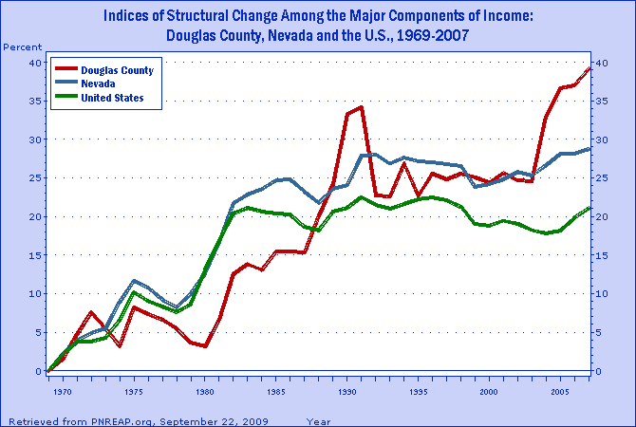
Figure 10. The "index of structural change" calibrates the timing and magnitude of change in the composition of personal income among the three major components for Douglas County, the State, and Nation from 1969-2007. The period of most dramatic change for all three spanned the period of the late 1970s to the mid-1980s. Over the past several decades one of the more heralded changes that has transformed the character of our economy has been the structural shift in employment and earnings from goods-producing toward services-producing activities. Though far less widely publicized and less popularly understood, another change of major significance was the widespread shifts in the composition of personal income.

Slide 12
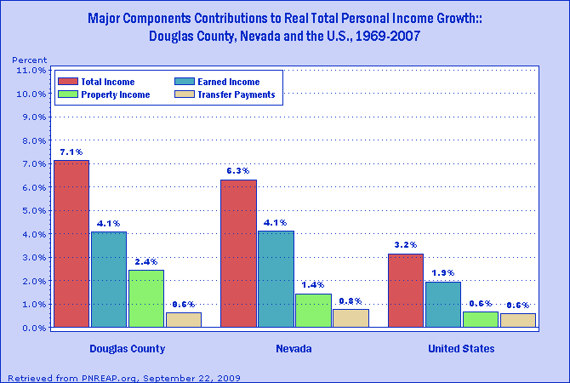
Figure 11. The amount that each income component contributed individually to Douglas County's real personal income growth over the 38-year period. The annual growth rate of Douglas County's real (inflation adjusted) personal income averaged 7.1% from 1969-2007.

Slide 13
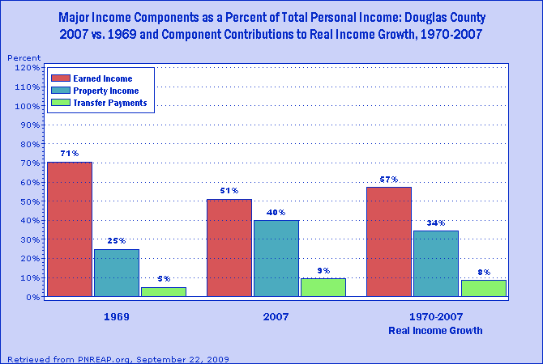
Figure 12. In 1969 earned income comprised 71% of Douglas County's total personal income. However, over the following 38-year period from 1969-2007, earned income accounted for only 57% of the annual real growth in Douglas County's personal income. As a result, by 2007 earned income's share declined to 51%. Because property income alone accounted for 34% of Douglas County's total personal income growth over 1969-2007, its share rose from 25% in 1969 to 40% in 2007. Transfer payments, in turn, advanced from 5% to 9% over the same period owing to its 8% contribution to the growth of Douglas County's total personal income.

Slide 14
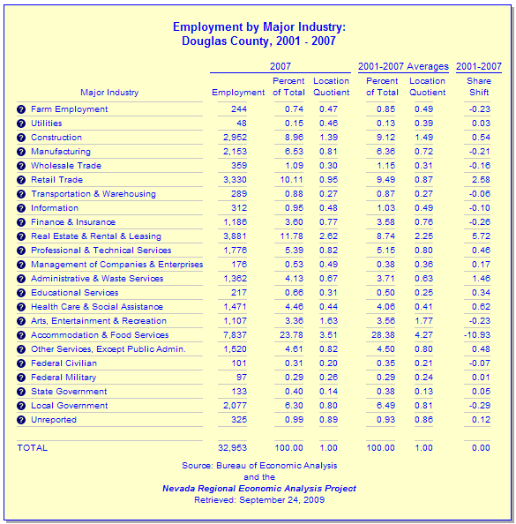
Table 1. Primary employment in Douglas County is in the Accommodation and Food Services, Real Estate and Rental and Leasing, and Retail sectors. These three sectors make up 46% of total county employment.

Slide 15
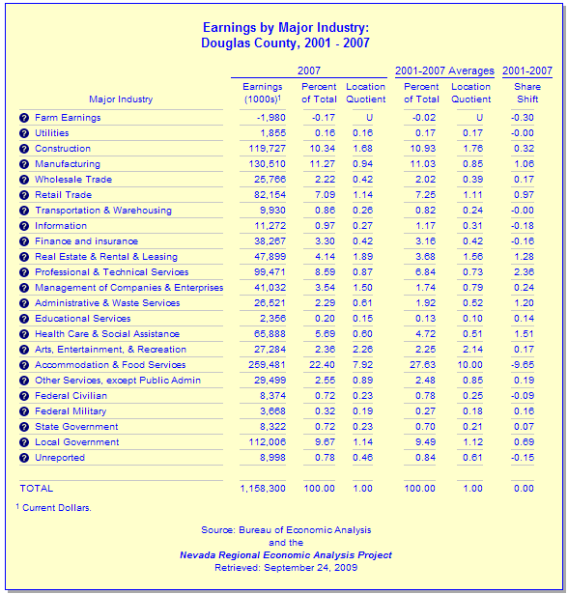
Table 2. Primary sectors for earnings per job are the Accommodation and Food Services, Construction, and the Manufacturing sectors. These three sectors make up 44% of total county earnings by industry.

Slide 16
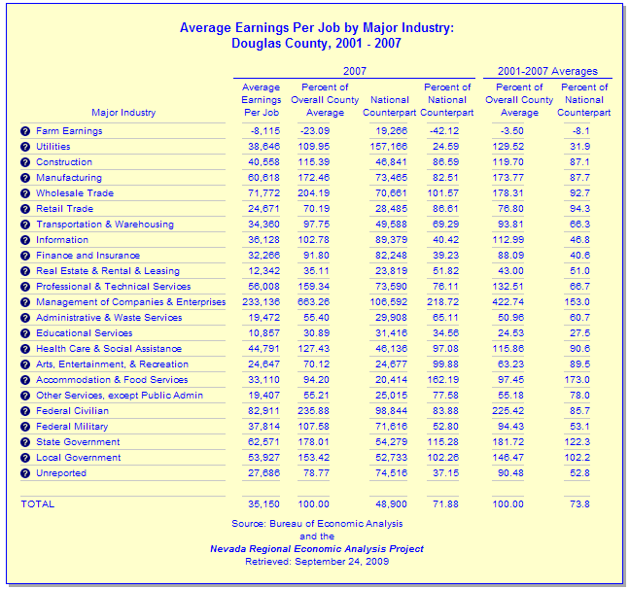
Table 3. Average earnings per job shows that in the private sector the top three sectors are the Management of Companies and Enterprises, Wholesale Trade, and Manufacturing sectors.

Slide 17
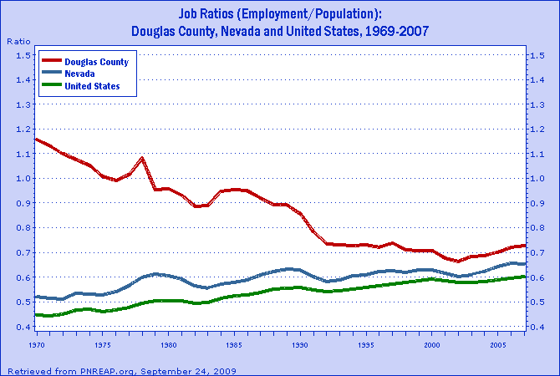
Figure 13. The job ratio is the number of full-time and part-time jobs by place of work, divided by population. The job ratio is useful in evaluating an economy's capacity to generate enough jobs to absorb the increasing number of workers attendant to a growing population. Nationally, the job ratio rose from 0.45 to 0.60 between 1969 and 2007. Douglas County's job ratio declined from 1.13 in 1969 to 0.73 in 2007. This means that there used to be more jobs than people, whereas now there are more people than jobs.

